Slide 1
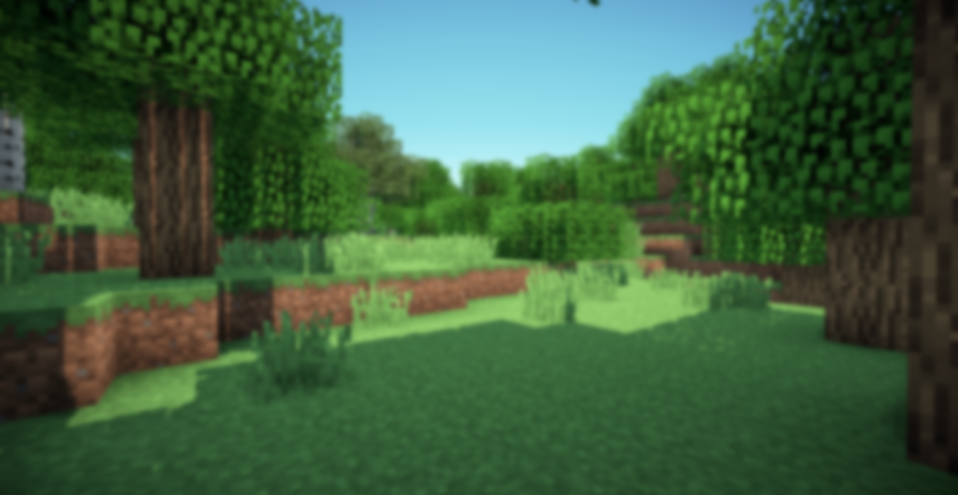


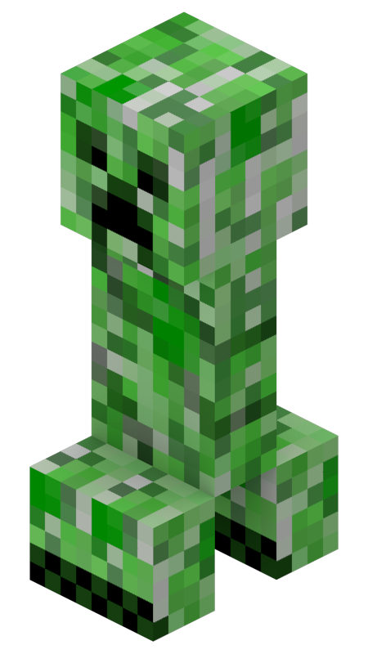
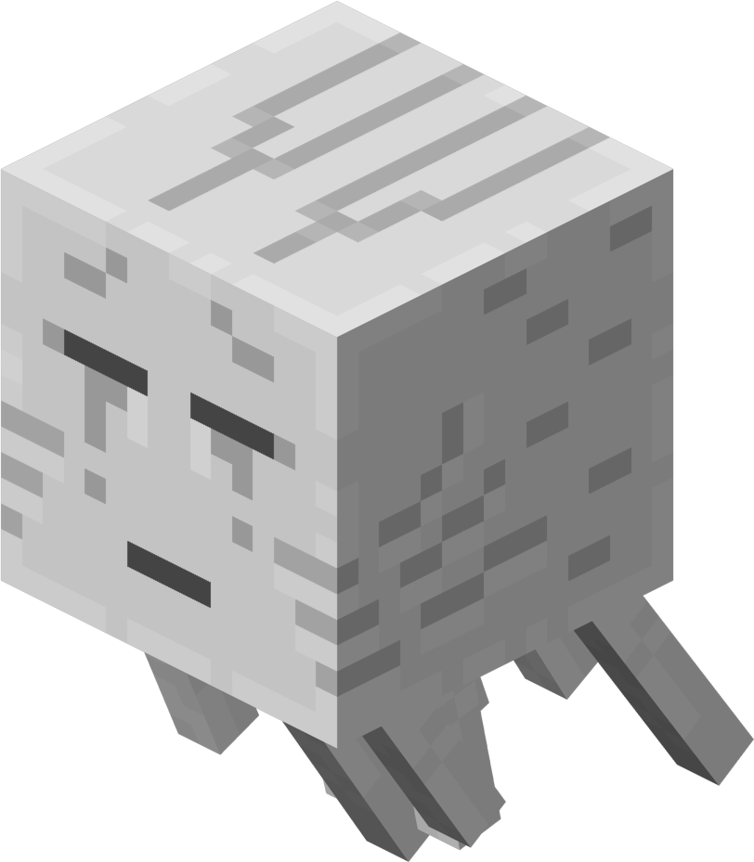
Start the Presentation
Options.
Quit

Slide 2
Loading……

Slide 3

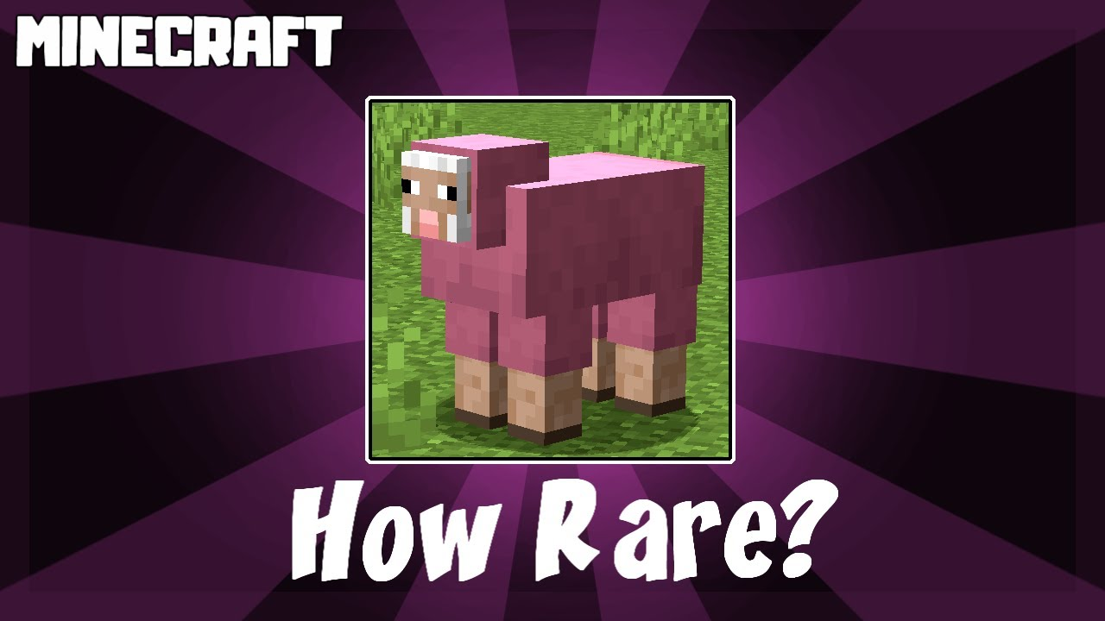
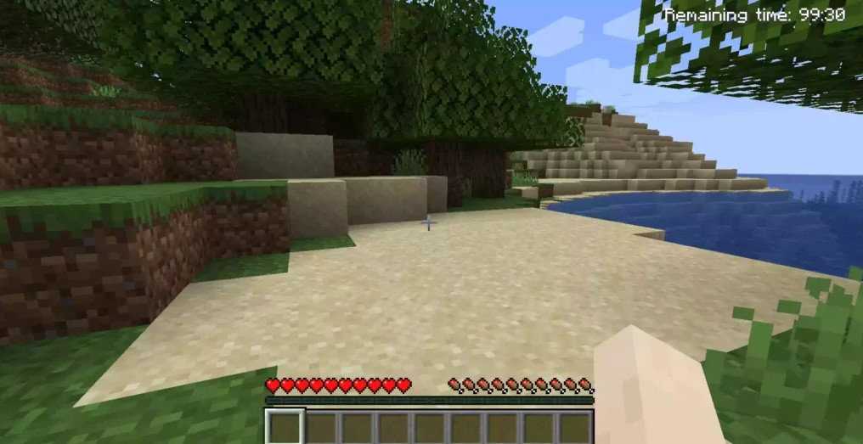
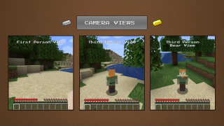
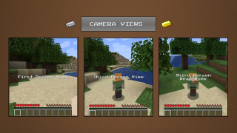

Slide 4
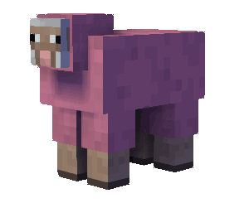


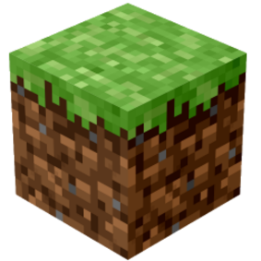
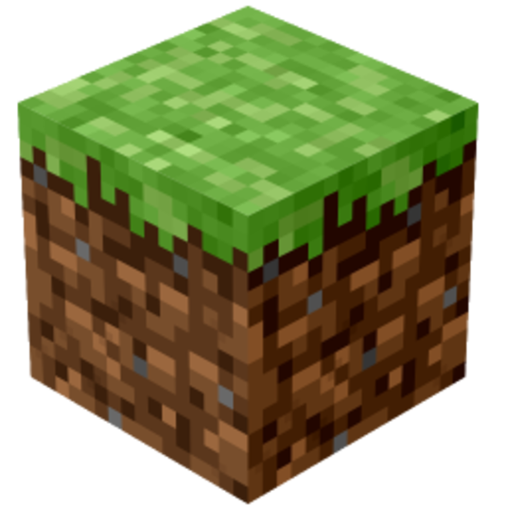
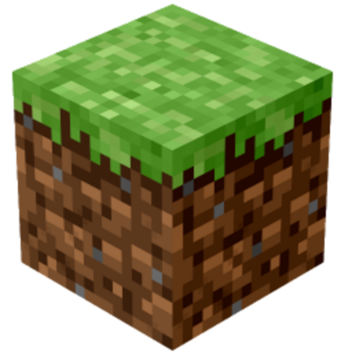
HOW TO PLAY ?
Mob
Data
Graph
Creeper
◇ Pink Sheep: A Rare Oddity ◇ A naturally spawning variant of regular sheep. ◇ One of the rarest passive mobs to encounter in Minecraft. ◇ Unlike typical sheep, Pink Sheep have an incredibly low natural spawn rate of 0.1558% (1 in 643) per Sheep.

Slide 5
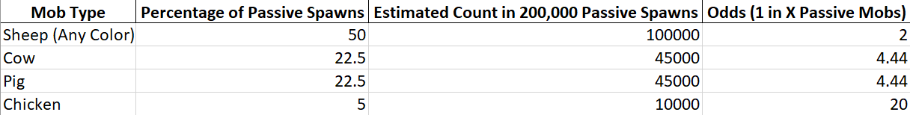
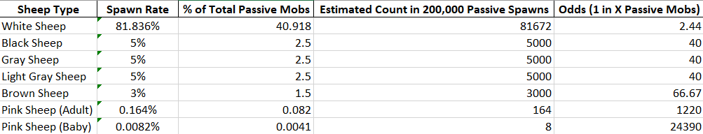

HOW TO PLAY ?
Mob
Data
Graph
Creeper

Slide 6
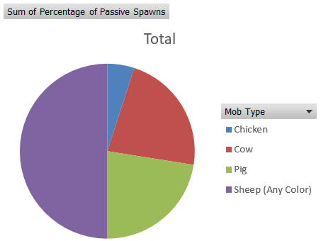
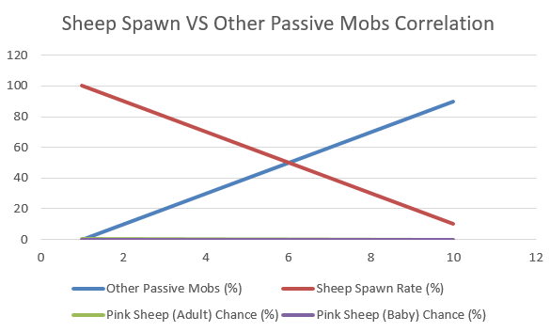
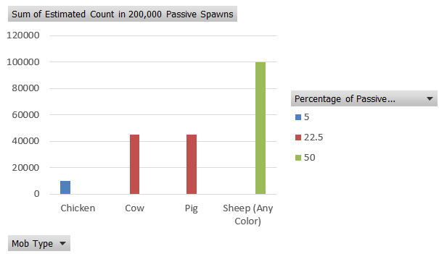
HOW TO PLAY ?
Arrow
Fight
Graph
Creeper

Slide 7
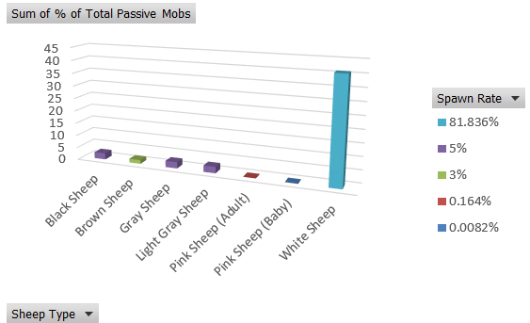
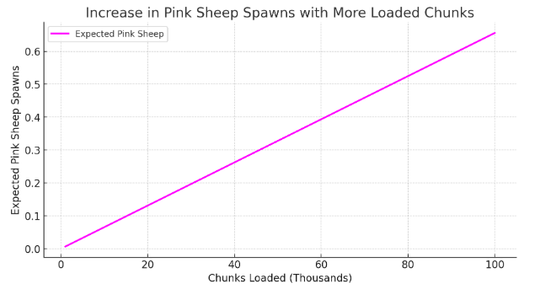
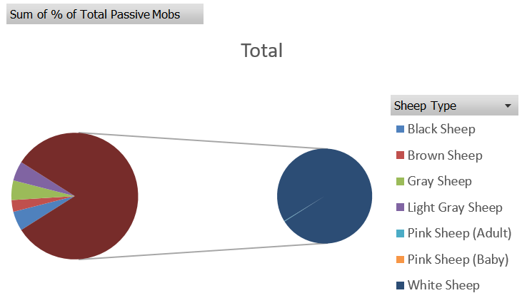
HOW TO PLAY ?
Arrow
Fight
Graph
Creeper

Slide 8

HOW TO PLAY ?
Arrow
Fight
Animals
Creeper
Inverse Relationship with Other Animals
If more cows, pigs, or chickens spawn, fewer sheep will generate. Since pink sheep are already rare, this effect makes them even harder to find.
Spawn Density vs. Rarity
The more chunks loaded and explored, the more sheep will spawn over time. Because pink sheep (especially baby pink sheep) are tied to a fixed probability, increasing total sheep spawns increases the chance of encountering one.

Slide 9
HOW TO PLAY ?
Arrow
Fight
Animals
Creeper
1. Pink Sheep are extremely rare, with only 0.164% of adult sheep and an even rarer 0.0082% for baby pink sheep. This makes the baby variant one of the rarest naturally spawning passive mobs in the game.
2. In 200,000 passive mob spawns, only ~164 adult pink sheep and ~8 baby pink sheep will appear.

Slide 10
YOU DIED!
Quit
Respawn
Requirement for Engr. Arvin Caabay
Midterm Presentation Requirement For ICT
A Creative Presentation by: Wayne Michael D. Camerino

